Slide 1


Nema Daghbandan, Esq.
CEO, Lightning Docs
Nema@lightningdocs.ai
Kevin Werner
CEO and Co-Founder, Renovo Financial
kevin@renovofinancial.com

Slide 2


DATASET
195,000+ Loans Analyzed
63k+ in 2025 and 48k+ YTD in 2026
$107+ Billion in Loans Since 2018
$30B in 2025 and $26.5B YTD in 2026
Trusted by over 60% of the National Top 50 Private Lenders

Slide 3
BRIDGE LOAN VOLUMES BY SAME USERS
January 2025 – July 2026
222 users
9.4% YOY Growth 2025 v 2026
+1%
+10%
+9%
+6%
+5%
+26%
+9%

Slide 4
VOLUME OF TOP 100 PRIVATE LENDERS
H1 2025 vs H1 2026
+2.4% Overall Growth
Top 100 Private Lenders, H1 2025 vs. H1 2026
Source: Elementix real estate data (lenderType=Private Money). Counts reflect mortgage records by recording date. Rankings sorted by FY 2025 count. Accessed 6 May 2026.

Slide 5
BRIDGE LOAN RATES & AVG. LOAN AMOUNTS
July 2025 – July 2026

Slide 6
BRIDGE LOAN INTEREST RATES
July Average:
9.99%
July 2026
3270 Loans

Slide 7
Average: 11.3%
MOST ACTIVE BRIDGE STATES BY VOLUME
2025 |  | 2026
STATE | LOANS | STATE | LOANS
California | 6,183 | California | 4,245
Florida | 4,058 | Florida | 2,594
Texas | 2,840 | Texas | 2,516
New Jersey | 1,306 | New Jersey | 926
North Carolina | 1,239 | Ohio | 923
Illinois | 1,055 | North Carolina | 866
Georgia | 925 | Georgia | 726
Massachusetts | 861 | Illinois | 655
Ohio | 850 | Washington | 631
Washington | 820 | Pennsylvania | 577
⇧ 5
⇩ 2
⇩ 2
⇧ 1
⇧ 1

Slide 8
Average: 11.3%
MOST ACTIVE BRIDGE COUNTIES BY VOLUME
2025 |  | 2026
County | # of Loans | County | # of Loans
Los Angeles, CA | 1,757 | Los Angeles, CA | 1,179
San Diego, CA | 1,420 | San Diego, CA | 908
Cook, IL | 743 | Cook, IL | 477
Miami-Dade, FL | 565 | Miami-Dade, FL | 464
Dallas, TX | 564 | Harris, TX | 453
Orange, CA | 449 | Dallas, TX | 437
Lee, FL | 407 | Orange, CA | 321
Pinellas, FL | 382 | Bexar, TX | 308
Santa Clara, CA | 382 | Santa Clara, PA | 269
Harris, TX | 356 | Pinellas, FL | 261
⇧ 5
⇩ 1
⇩ 1
⇧ 7
⇧ 4

Slide 9
ACTIVE BRIDGE COUNTY RATE VOLATILITY
Average: 11.3%
COUNTY | May |  |  | June |  |  | July
 | Int. Rate | Loan Amount | # of Loans | Int. Rate | Loan Amount | # of Loans | Int. Rate | Loan Amount | # of Loans
Los Angeles, CA | 10.06% | $1,121,094 | 169 | 10.19% | $1,149,698 | 182 | 10.29% | $1,145,122 | 168
San Diego, CA | 10.01% | $956,758 | 128 | 9.67% | $1,060,200 | 140 | 9.62% | $1,102,962 | 150
Cook, IL | 10.65% | $718,504 | 70 | 10.48% | $544,858 | 68 | 10.28% | $363,256 | 71
Miami-Dade, FL | 9.61% | $1,122,768 | 63 | 9.18% | $1,221,907 | 69 | 9.07% | $1,417,837 | 67
Harris, TX | 9.71% | $488,276 | 74 | 9.81% | $409,950 | 70 | 9.97% | $475,117 | 75
Dallas, TX | 9.79% | $953,297 | 51 | 10.34% | $749,822 | 64 | 9.68% | $881,178 | 64
Orange, CA | 9.96% | $1,366,195 | 53 | 9.99% | $1,287,135 | 62 | 9.83% | $1,302,273 | 39
Bexar, TX | 9.97% | $378,607 | 45 | 10.14% | $187,120 | 61 | 9.86% | $301,443 | 27
Santa Clara, CA | 8.92% | $1,520,539 | 47 | 9.47% | $1,655,365 | 45 | 9.27% | $1,620,773 | 32
Pinellas, FL | 9.61% | $437,850 | 40 | 9.82% | $649,990 | 41 | 9.34% | $486,456 | 37

Slide 10
ACTIVE CA BRIDGE COUNTY RATE VOLATILITY
Average: 11.3%
COUNTY | May |  |  | June |  |  | July
 | Int. Rate | Loan Amount | # of Loans | Int. Rate | Loan Amount | # of Loans | Int. Rate | Loan Amount | # of Loans
Los Angeles, CA | 10.06% | $1,120,148 | 169 | 10.18% | $1,159,917 | 187 | 10.29% | $1,145,122 | 168
San Diego, CA | 10.01% | $956,758 | 128 | 9.66% | $1,073,540 | 141 | 9.62% | $1,102,962 | 150
Orange, CA | 9.96% | $1,366,195 | 53 | 9.99% | $1,287,619 | 62 | 9.81% | $1,294,716 | 40
Santa Clara, CA | 8.92% | $1,520,539 | 47 | 9.50% | $1,608,303 | 46 | 9.27% | $1,620,773 | 32
Alameda, CA | 9.64% | $1,220,377 | 29 | 9.65% | $978,596 | 27 | 9.63% | $1,089,407 | 34
San Francisco, CA | 9.36% | $1,724,723 | 25 | 9.63% | $2,246,164 | 19 | 9.48% | $1,595,850 | 21
Fresno, CA | 10.39% | $351,616 | 22 | 9.99% | $431,507 | 24 | 10.74% | $365,993 | 17
Riverside, CA | 10.67% | $782,810 | 14 | 10.66% | $594,869 | 27 | 10.06% | $869,953 | 15
San Bernardino, CA | 10.66% | $739,324 | 14 | 10.29% | $518,782 | 18 | 10.85% | $846,310 | 22
Sacramento, CA | 10.03% | $579,094 | 15 | 9.83% | $732,479 | 17 | 9.78% | $714,311 | 15

Slide 11
ACTIVE FL BRIDGE COUNTY RATE VOLATILITY
Average: 11.3%
COUNTY | May |  |  | June |  |  | July
 | Int. Rate | Loan Amount | # of Loans | Int. Rate | Loan Amount | # of Loans | Int. Rate | Loan Amount | # of Loans
Miami-Dade, FL | 9.61% | $1,122,768 | 63 | 9.18% | $1,221,907 | 69 | 9.07% | $1,417,837 | 67
Pinellas, FL | 9.60% | $473,189 | 40 | 9.82% | $649,990 | 41 | 9.34% | $486,456 | 37
Broward, FL | 9.60% | $844,221 | 31 | 9.54% | $818,124 | 31 | 9.32% | $1,118,743 | 33
Duval, FL | 9.66% | $616,008 | 26 | 10.14% | $379,187 | 36 | 9.87% | $239,081 | 27
Lee, FL | 10.11% | $574,967 | 30 | 9.73% | $441,491 | 27 | 9.74% | $279,559 | 28
Hillsborough, FL | 9.71% | $1,025,355 | 19 | 9.36% | $1,250,612 | 19 | 9.51% | $642,374 | 28
Palm Beach, FL | 9.92% | $1,456,702 | 21 | 9.89% | $1,110,558 | 24 | 9.94% | $1,214,016 | 19
Orange, FL | 9.52% | $1,052,396 | 25 | 9.46% | $807,440 | 19 | 9.24% | $985,438 | 13
Sarasota, FL | 10.02% | $1,138,457 | 16 | 9.97% | $534,299 | 12 | 9.70% | $1,160,969 | 11
Polk, FL | 10.75% | $229,998 | 4 | 9.96% | $226,739 | 14 | 10.14% | $324,928 | 10

Slide 12
ACTIVE TX BRIDGE COUNTY RATE VOLATILITY
Average: 11.3%
COUNTY | May |  |  | June |  |  | July
 | Int. Rate | Loan Amount | # of Loans | Int. Rate | Loan Amount | # of Loans | Int. Rate | Loan Amount | # of Loans
Harris, TX | 9.71% | $488,276 | 74 | 9.81% | $409,950 | 70 | 9.97% | $475,117 | 75
Dallas, TX | 9.79% | $953,297 | 51 | 10.37% | $747,763 | 65 | 9.68% | $881,178 | 64
Bexar, TX | 9.97% | $378,607 | 45 | 10.14% | $187,120 | 61 | 9.86% | $301,443 | 27
Travis, TX | 10.57% | $726,828 | 19 | 10.34% | $874,456 | 44 | 10.38% | $1,199,699 | 23
Tarrant, TX | 9.88% | $497,575 | 15 | 9.80% | $412,839 | 33 | 9.96% | $263,970 | 23
Hidalgo, TX | 11.18% | $619,654 | 12 | 11.02% | $527,663 | 24 | 10.64% | $260,886 | 23
Collin, TX | 9.79% | $503,860 | 5 | 9.70% | $532,275 | 21 | 9.59% | $405,455 | 15
Montgomery, TX | 9.56% | $480,575 | 4 | 10.06% | $350,054 | 20 | 9.97% | $492,505 | 11
Williamson, TX | 11.04% | $296,791 | 7 | 10.62% | $599,209 | 11 | 11.45% | $308,850 | 6
Denton, TX | 9.35% | $490,453 | 5 | 9.90% | $1,214,194 | 8 | 10.16% | $1,193,458 | 10

Slide 13
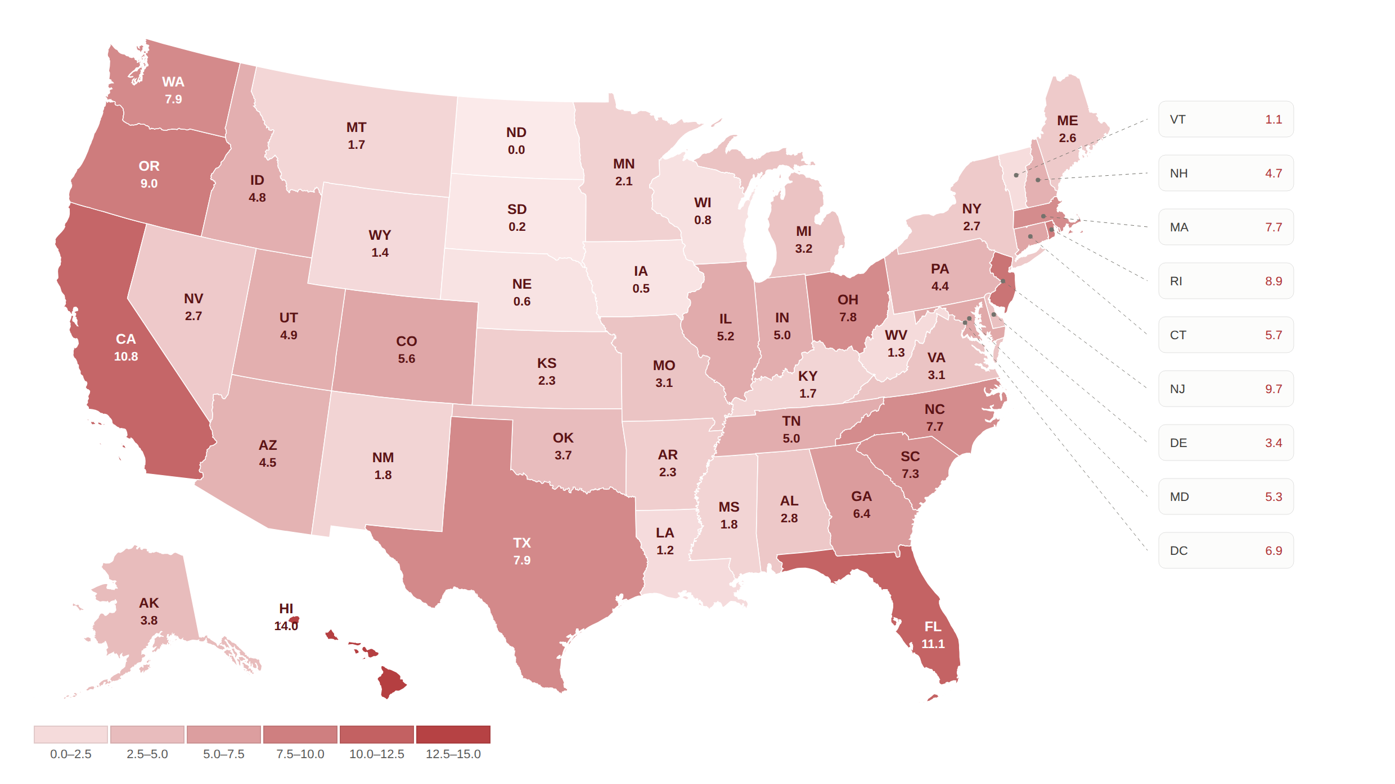
BRIDGE LOANS PER 100,000 RESIDENTS
Average: 11.3%

Slide 14
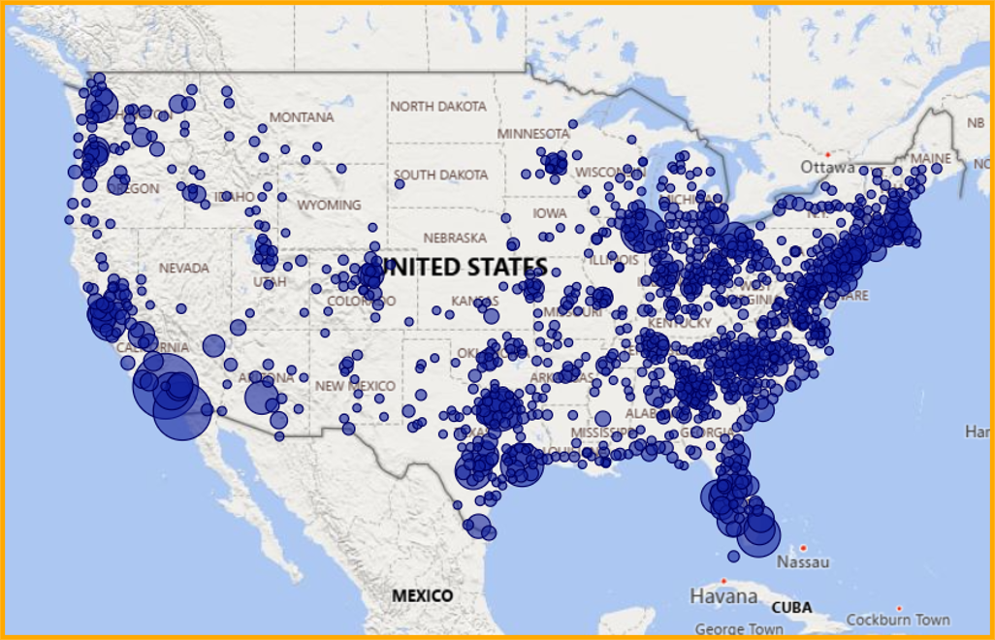
BRIDGE ACTIVITY 2026
Average: 11.3%

Slide 15
DSCR LOAN VOLUMES BY SAME USERS
January 2025 – July 2026
54 users
35.8% YOY Growth 2025 v 2026
+46%
+59%
+53%
+38%
+17%
+23%
+19%

Slide 16
DSCR LOAN RATES & AVG. LOAN AMOUNTS
July 2025 – July 2026

Slide 17
DSCR LOAN INTEREST RATES
July Average:
7.16%
July 2026
4,337 Loans

Slide 18
BRIDGE & DSCR VS INDEXES
July 2025 – July 2026

Slide 19
Average: 11.3%
TOP DSCR STATES BY VOLUME
2025 |  | 2026
STATE | LOANS | STATE | LOANS
Florida | 3,766 | Florida | 2,844
Ohio | 3,146 | Texas | 2,510
Texas | 3,126 | Ohio | 2,367
Pennsylvania | 2,960 | Pennsylvania | 1,930
New Jersey | 2,316 | New Jersey | 1,451
New York | 1,944 | New York | 1,423
California | 1,767 | California | 1,284
Georgia | 1,233 | North Carolina | 945
North Carolina | 1,122 | Michigan | 881
Illinois | 1,113 | Georgia | 849
⇧ 1
⇩ 1
⇧ 1
⇧ 2
⇩ 2

Slide 20
F
Average: 11.3%
TOP DSCR COUNTIES BY VOLUME
2025 |  | 2026
County | # of Loans | County | # of Loans
Cuyahoga, OH | 1149 | Cuyahoga, OH | 712
Philadelphia, PA | 931 | Wayne, MI | 593
Cook, IL | 685 | Harris, TX | 584
Wayne, MI | 682 | Philadelphia, PA | 543
Harris, TX | 677 | Miami-Dade, FL | 483
Miami-Dade, FL | 580 | Cook, IL | 476
St. Louis, MO | 498 | Allegheny, PA | 348
Los Angeles, CA | 477 | Baltimore City, MD | 342
Allegheny, PA | 474 | Dallas, TX | 332
Dallas, TX | 457 | Maricopa, AZ | 299
⇧ 2
⇧ 2
⇩ 2
⇧ 1
⇩ 3
⇧ 2
⇧ 5
⇧ 1
⇧ 6

Slide 21
ACTIVE DSCR COUNTY RATE VOLATILITY
Average: 11.3%
COUNTY | May |  |  | June |  |  | July
 | Int. Rate | Loan Amount | # of Loans | Int. Rate | Loan Amount | # of Loans | Int. Rate | Loan Amount | # of Loans
Cuyahoga, OH | 7.24% | $138,224 | 100 | 7.38% | $125,962 | 88 | 7.33% | $145,188 | 107
Wayne, MI | 7.32% | $153,387 | 85 | 7.40% | $209,178 | 92 | 7.29% | $167,577 | 94
Harris, TX | 6.95% | $282,867 | 72 | 7.19% | $397,542 | 68 | 7.26% | $266,981 | 110
Philadelphia, PA | 7.13% | $224,531 | 80 | 7.20% | $201,349 | 105 | 7.19% | $244,126 | 84
Miami-Dade, FL | 6.85% | $403,872 | 67 | 7.09% | $457,195 | 94 | 7.10% | $533,751 | 79
Cook, IL | 7.27% | $310,896 | 41 | 7.17% | $296,065 | 81 | 7.20% | $323,513 | 84
Allegheny, PA | 7.25% | $215,399 | 45 | 7.23% | $226,819 | 47 | 7.40% | $291,210 | 38
Baltimore City, MD | 7.07% | $184,980 | 25 | 7.20% | $242,574 | 38 | 7.05% | $211,640 | 26
Dallas, TX | 6.94% | $309,970 | 45 | 7.12% | $292,263 | 58 | 7.03% | $246,511 | 60
Maricopa, AZ | 6.86% | $458,663 | 38 | 7.10% | $394,693 | 65 | 7.01% | $440,024 | 45

Slide 22
ACTIVE FL DSCR COUNTY RATE VOLATILITY
Average: 11.3%
COUNTY | May |  |  | June |  |  | July
 | Int. Rate | Loan Amount | # of Loans | Int. Rate | Loan Amount | # of Loans | Int. Rate | Loan Amount | # of Loans
Miami-Dade, FL | 6.85% | $403,872 | 67 | 7.09% | $457,195 | 94 | 7.10% | $533,751 | 79
Broward, FL | 6.88% | $447,866 | 25 | 6.96% | $578,459 | 42 | 7.23% | $416,752 | 44
Lee, FL | 7.38% | $293,666 | 22 | 7.14% | $260,185 | 29 | 7.16% | $311,025 | 32
Pasco, FL | 6.69% | $254,836 | 14 | 6.97% | $168,092 | 52 | 6.84% | $262,904 | 14
Hillsborough, FL | 7.21% | $521,208 | 12 | 6.98% | $439,695 | 19 | 6.60% | $224,565 | 40
Palm Beach, FL | 6.96% | $562,850 | 21 | 7.07% | $375,975 | 20 | 7.08% | $458,409 | 27
Duval, FL | 7.08% | $189,991 | 19 | 6.88% | $230,397 | 24 | 7.20% | $261,428 | 20
Osceola, FL | 6.94% | $250,987 | 16 | 6.72% | $423,407 | 19 | 7.08% | $336,363 | 25
Orange, FL | 6.70% | $326,799 | 18 | 7.09% | $375,094 | 15 | 7.07% | $268,130 | 24
Pinellas, FL | 7.02% | $377,128 | 16 | 6.90% | $351,804 | 18 | 7.00% | $417,312 | 17

Slide 23
ACTIVE TX DSCR COUNTY RATE VOLATILITY
Average: 11.3%
COUNTY | February |  |  | March |  |  | April
 | Int. Rate | Loan Amount | # of Loans | Int. Rate | Loan Amount | # of Loans | Int. Rate | Loan Amount | # of Loans
Harris, TX | 6.95% | $282,867 | 72 | 7.19% | $397,542 | 68 | 7.26% | $266,944 | 110
Dallas, TX | 6.94% | $309,970 | 45 | 7.12% | $292,263 | 58 | 7.03% | $246,536 | 60
Bexar, TX | 7.01% | $187,226 | 38 | 7.05% | $168,778 | 20 | 7.01% | $226,479 | 36
Tarrant, TX | 7.03% | $255,475 | 15 | 7.17% | $229,487 | 20 | 6.84% | $290,536 | 29
Montgomery, TX | 6.97% | $200,006 | 4 | 6.89% | $272,828 | 26 | 7.02% | $323,595 | 12
Travis, TX | 7.15% | $437,184 | 16 | 7.48% | $503,445 | 9 | 6.78% | $398,458 | 13
Bell, TX | 7.01% | $212,550 | 13 | 6.84% | $195,030 | 10 | 7.08% | $181,250 | 9
Collin, TX | 6.68% | $301,356 | 7 | 6.82% | $259,490 | 11 | 7.33% | $312,793 | 11
Jefferson, TX | 7.36% | $154,775 | 10 | 7.26% | $224,095 | 14 | 7.06% | $243,734 | 5
Fort Bend, TX | 7.34% | $211,176 | 7 | 7.01% | $235,889 | 10 | 7.04% | $285,827 | 11

Slide 24
ACTIVE OH DSCR COUNTY RATE VOLATILITY
Average: 11.3%
COUNTY | May |  |  | June |  |  | July
 | Int. Rate | Loan Amount | # of Loans | Int. Rate | Loan Amount | # of Loans | Int. Rate | Loan Amount | # of Loans
Cuyahoga, OH | 7.24% | $138,224 | 100 | 7.38% | $125,962 | 88 | 7.33% | $145,188 | 107
Franklin, OH | 6.89% | $302,893 | 22 | 6.97% | $259,866 | 43 | 7.14% | $252,951 | 35
Montgomery, OH | 6.99% | $153,043 | 22 | 7.21% | $160,110 | 36 | 7.07% | $190,806 | 30
Lucas, OH | 7.64% | $77,518 | 26 | 7.67% | $100,934 | 29 | 7.61% | $81,733 | 26
Hamilton, OH | 6.97% | $245,427 | 24 | 7.06% | $211,617 | 24 | 6.95% | $277,617 | 29
Summit, OH | 7.08% | $245,117 | 10 | 7.29% | $211,793 | 33 | 6.90% | $124,778 | 28
Butler, OH | 7.18% | $195,470 | 10 | 7.00% | $135,615 | 14 | 6.99% | $253,359 | 12
Lorain, OH | 6.86% | $104,876 | 20 | 7.53% | $119,864 | 11 | 7.25% | $141,999 | 5
Stark, OH | 7.33% | $164,620 | 5 | 7.43% | $123,839 | 7.43% | 7.05% | $259,217 | 6
Clark, OH | 7.10% | $109,125 | 2 | 7.09% | $221,667 | 3 | 6.85% | $192,000 | 2

Slide 25
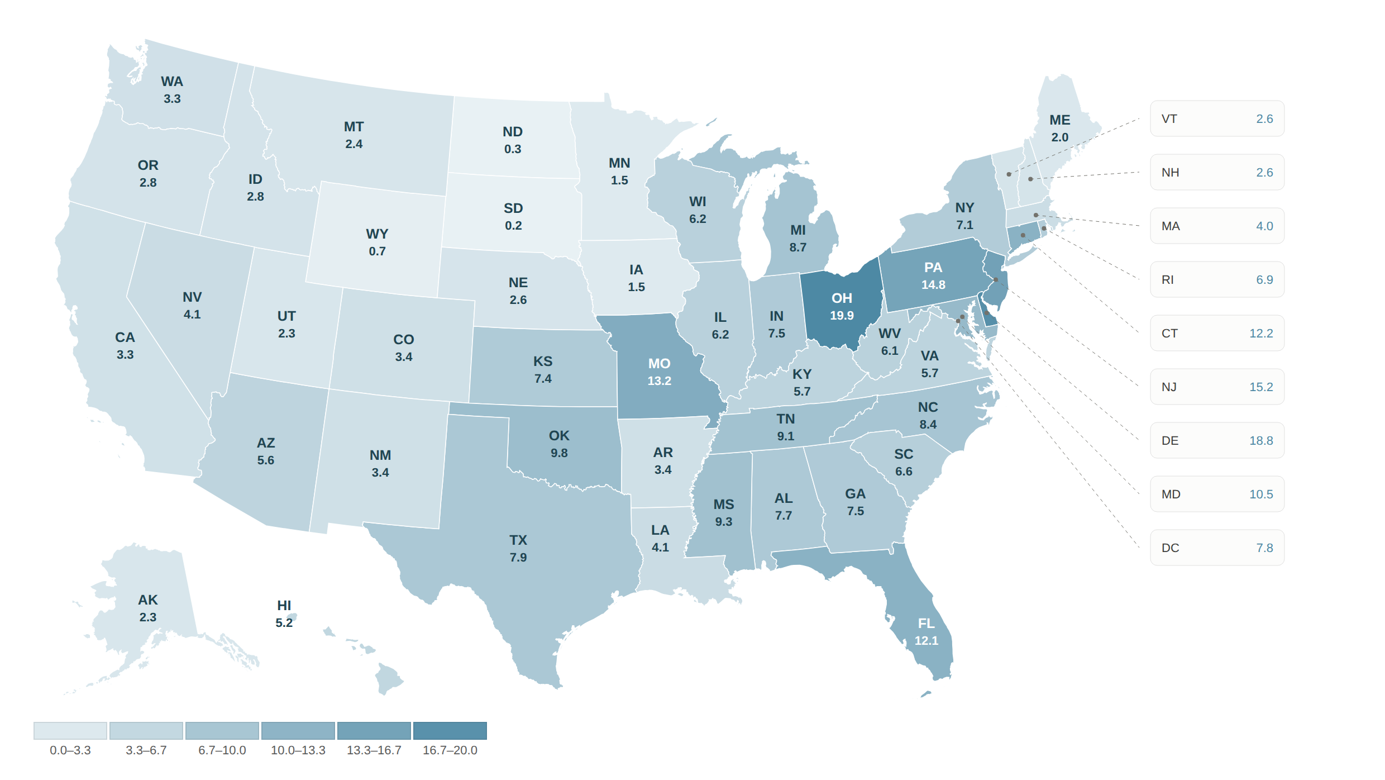
DSCR LOANS PER 100,000 RESIDENTS
Average: 11.3%

Slide 26
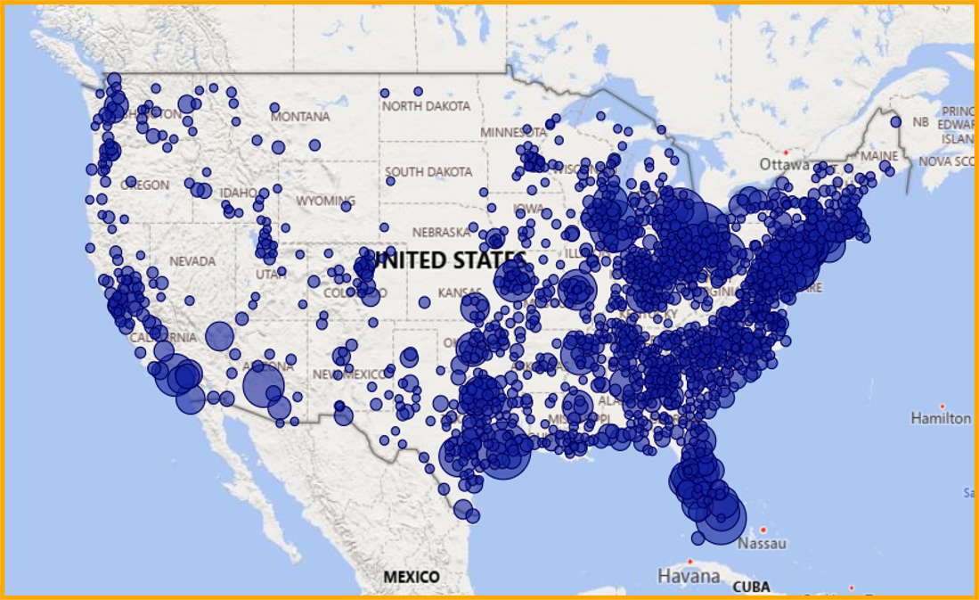
DSCR ACTIVITY 2026
Average: 11.3%

Slide 27
Nema Daghbandan, Esq.
CEO, Lightning Docs
Nema@lightningdocs.ai
Kevin Werner
CEO and Co-Founder, Renovo Financial
kevin@renovofinancial.com

